Slide 1
Cooperative Principles & Cooperative Economics viv grigg, 2020
BAsed on GrigG ch 7, Wikipedia et. Al.
Principle #4: God is a cooperative. The disciples held a common purse. The Early church practiced communal sharing.
These principles are the Christian cultural foundation of the cooperative movement in the industrial age of and the 2nd Great Awakening. Cooperatives grew out of Methodist and Baptist teachings.

Slide 2
The Common Purse and the Salvation of Europe
How does the story of Judas relate to European Cities?
He kept the Common Purse
Acts 2 Expands the concept of the Common Purse to the common Purse of a whole Community of Faith
Th Irish friars who evangelized rope in the 5th – 9th century established monasteries with a common purse. These become the center of industry. Thus were the European cities born.

Slide 3
The Principle of Diffusion of Power
The Biblical principle of the dignity of each person
Leads to a principle of equality
This leads to a principle of diffusion of power, of pushing power down as far as is feasible to the people.
The anointing of A King by Samuel holds a debate about the centralization of power as fundamentally opposed to justice.
In the Acts Community and in Paul’s establishment of congregations this is shown as decision-making from both the top down and the bottom up.
In the reformation, the principle that each man has a direct line to God, released the principle of the ministry of the laity, which in turn lead to concepts of Democracy coming to the fore.
At national levels, some speak of Democrative Socialism, some of Democratic Capitalism – economics of, for and by the people. The foundational Biblical principles are there, the utworkings are varied.

Slide 4
Progressions in CMED
Receiving Christ and Discipleship
Community of Faith and Character
Cooperative Savings (ASCA, ROSCA)
Cooperative Capital
Developing Business Skills
Microfinances (MFD) (Now Peer to Peer)
SHG Bank Linkages
Migration to Capital-rich context
All part of Christian Micro-Enterprise Development

Slide 5
Context: Four Main Escapes from Poverty
Upper and lower level circuits in urban economies
Four main means of escape
  Mass Migration – to a place with capital
  Education – personal skills and knowledge capital
  Cooperatives – monetary capital formation through mutual support
  Skills and technology transfer – transfer of technological capital

Slide 6
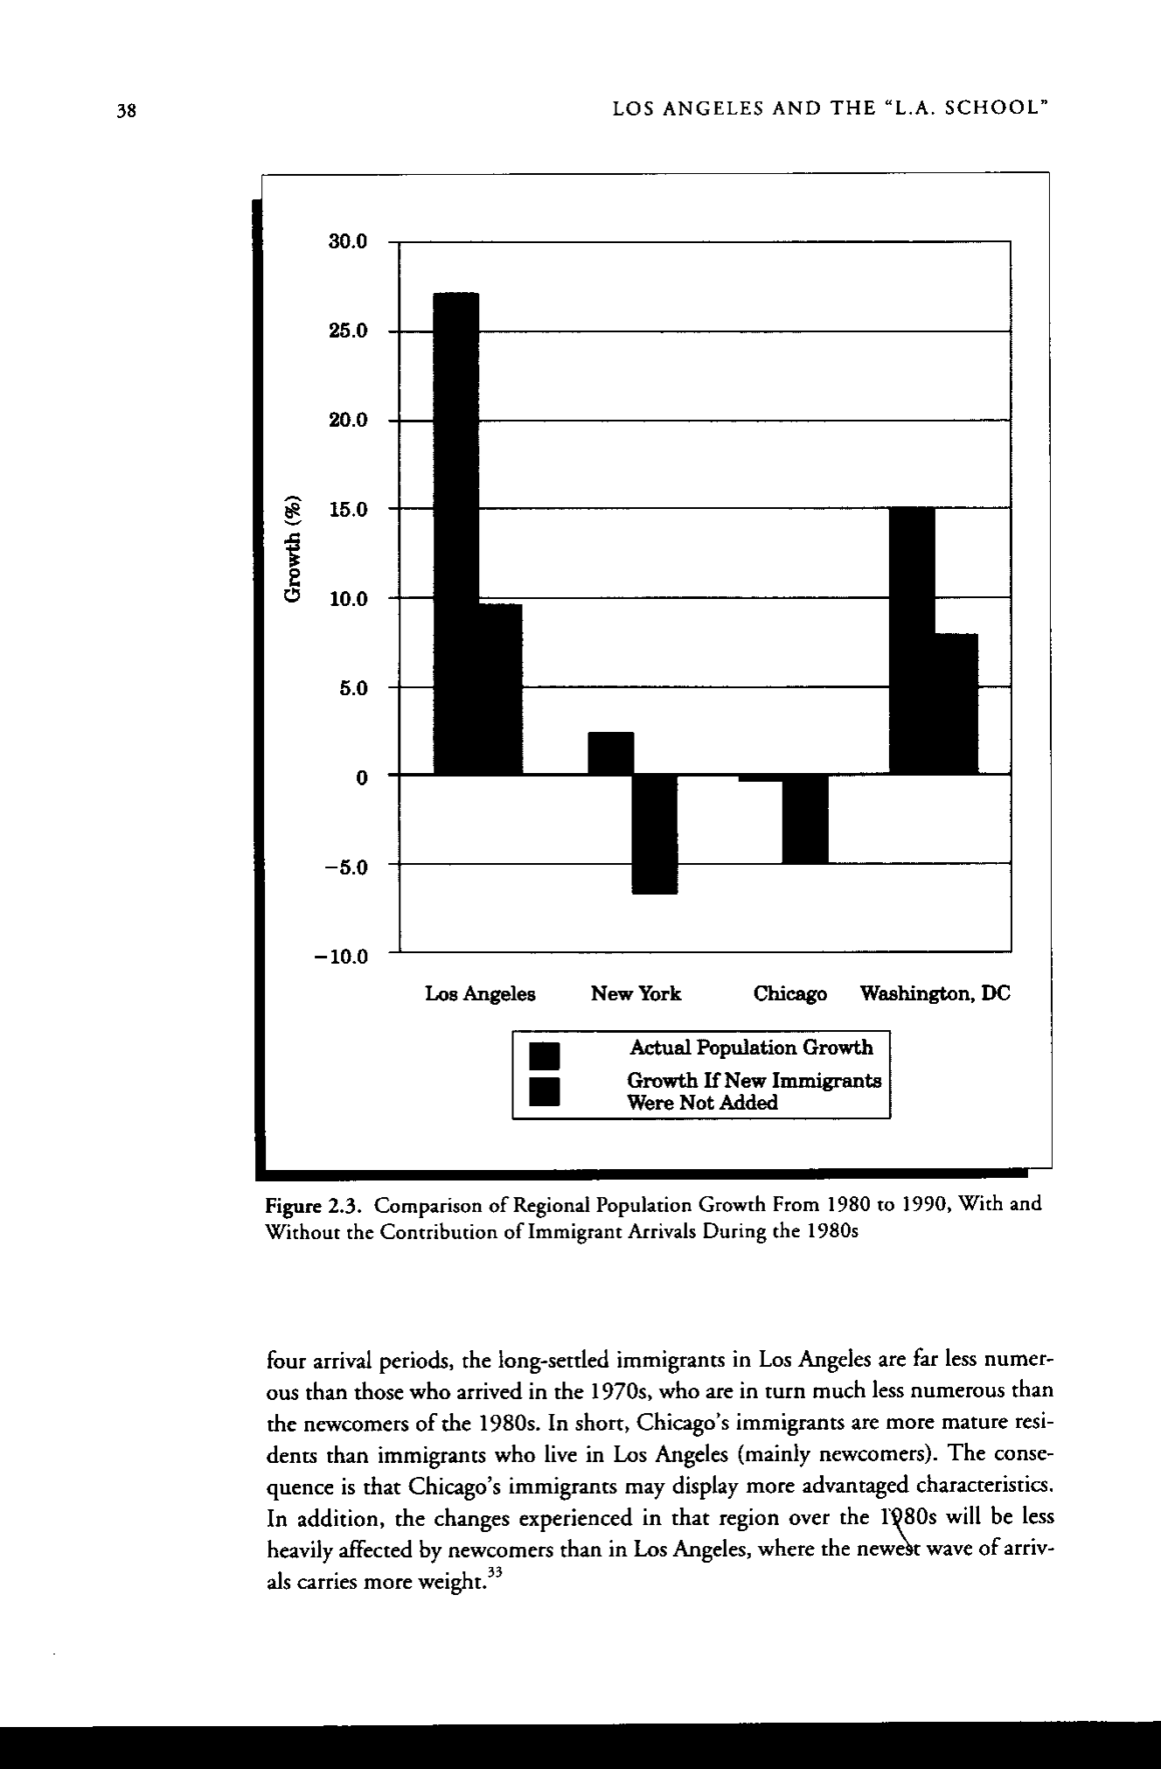
Migration to LA
Global cities are about 1/3 migrants, 1/3 born in the city, 1/3 older residents.

Slide 7
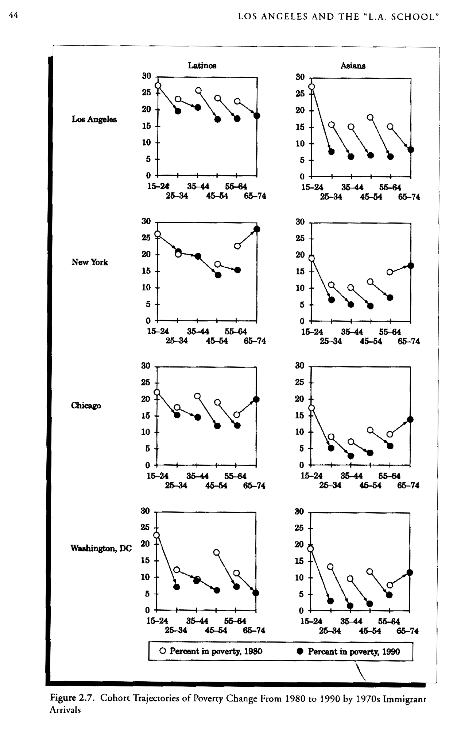
Principle 9 Ownership
Housing in LA
Capitalism can provide wealth that enables construction, but without governmentally mandated cooperative and redistributive governmental policies forcing the building of low cost housing, it will not provide for the poor.

Slide 8
Co-operative economics
Co-operative economics is a field of economics, socialist economics, co-operative studies, and political economy, which is concerned with co-operatives.
Notable theoreticians who have contributed to the field include Robert Owen,^{[1]} Pierre-Joseph Proudhon, Charles Gide,^{[2]} Beatrice and Sydney Webb,^{[3]} J.T.W. Mitchell, Peter Kropotkin,^{[4]} Paul Lambart,^{[5]} Race Mathews,^{[6]} David Griffiths,^{[7]} and G.D.H. Cole.^{[8]} Historical co-operative movements, such as the Rochdale Pioneers, have also contributed to the field.

Slide 9
Definition of a Cooperative
A cooperative (also co-operative; often referred to as a co-op) is a business organization owned and operated by a group of individuals for their mutual benefit.^{[1]}
Cooperatives are defined by the International Co-operative Alliance's Statement on the Co-operative Identity as autonomous associations of persons united voluntarily to meet their common economic, social, and cultural needs and aspirations through jointly-owned and democratically-controlled enterprises.^{[2]}
A cooperative may also be defined as a business owned and controlled equally by the people who use its services or by the people who work there. Cooperative enterprises are the focus of study in the field of cooperative economics.

Slide 10
Origins
Consumers' cooperative shops in the UK formed the world's first mass cooperative movement
Cooperation dates back as far as human beings have been organising for mutual benefit. Tribes were organised as cooperative structures, allocating jobs and resources among each other, only trading with the external communities.
The guilds of tradesmen in European cities in the 15th and 16th centuries preceded the cooperative movements (Max Weber, the City).

Slide 11
Origins
In 1761, the Fenwick Weavers' Society was formed in Fenwick, East Ayrshire, Scotland to sell discounted oatmeal to local workers.^{[3]} Its services expanded to include assistance with savings and loans, emigration and education.
In 1810, Welsh social reformer Robert Owen, from Newtown in mid-Wales, and his partners purchased New Lanark mill from Owen's father-in-law and proceeded to introduce better labor standards including discounted retail shops where profits were passed on to his employees. Owen left New Lanark to pursue other forms of co-operative organization and develop co-op ideas through writing and lecture.
In 1828, William King set up a newspaper, The Cooperator, to promote Owen's thinking, having already set up a co-operative store in Brighton.

Slide 12
Origins
The Rochdale Society of Equitable Pioneers, founded in 1844, is usually considered the first successful co-operative enterprise, used as a model for modern co-ops, following the 'Rochdale Principles'. A group of 28 weavers and other artisans in Rochdale, England set up the society to open their own store selling food items they could not otherwise afford. Within ten years there were over 1,000 co-operative societies in the United Kingdom.
In the final year of the 20th century, cooperatives banded together to establish a number of social enterprise agencies which have moved to adopt the multi-stakeholder cooperative model.^{[4][5]}
In the last 15 years (1994 - 2009) the EU and its member nations, have gradually revised national accounting systems to "make visible" the increasing contribution of social economy organizations.^{[6]}

Slide 13
Organizational and ideological roots
In the Anglosphere, post-feudal forms of cooperation between workers and owners, that are expressed today as "profit-sharing" and "surplus sharing" arrangements, existed as far back as 1795.^{[7]}
The key ideological influence on the Anglosphere branch of the cooperative movement, however, was a rejection of the charity principles that underpinned welfare reforms when the British government radically revised its Poor Laws in 1834. As both state and church institutions began to routinely distinguish between the 'deserving' and 'undeserving' poor, a movement of friendly societies grew throughout the British Empire based on the principle of mutuality, committed to self-help in the welfare of working people.
Friendly Societies established forums through which one member, one vote was practiced in organisation decision-making. The principles challenged the idea that a person should be an owner of property before being granted a political voice.^{[4]}
Throughout the second half of the nineteenth century (and then repeatedly every 20 years or so) there has been a surge in the number of cooperative organisations, both in commercial practice and civil society, operating to advance democracy and universal suffrage as a political principle.^{[8]}

Slide 14
Organizational and ideological roots
Friendly Societies and consumer cooperatives became the dominant form of organization amongst working people in Anglosphere industrial societies prior to the rise of trade unions and industrial factories. Weinbren reports that by the end of the 19th century, over 80% of British working age men and 90% of Australian working age men were members of one or more Friendly Society.^{[9]}

Slide 15
Upping the Ante:
The Jubilee as National Common Purse
Individual or clan ownership is affirmed in the Jubilee and throughout the scriptures. Which parts of society should be privately owned?
Which parts of society belong to all?
Lakes? Forests? Sea? Beaches? Industrial Produce?
If some things are Collective, who makes the decisions?
This is the healthy(?) tension between left and right in First World Economies.

Slide 16
Organizational and ideological roots
From the mid-nineteenth century, mutual organisations embraced these ideas in economic enterprises, firstly amongst tradespeople, and later in cooperative stores, educational institutes, financial institutions and industrial enterprises. The common thread (enacted in different ways, and subject to the constraints of various systems of national law) is the principle that an enterprise or association should be owned and controlled by the people it serves, and share any surpluses on the basis of each members' cooperative contribution (as a producer, labourer or consumer) rather than their capacity to invest financial capital.^{[10]}

Slide 17
Organizational and ideological roots
The cooperative movement has been fueled globally by ideas of economic democracy. Economic democracy is a socio-economic philosophy that suggests an expansion of decision-making power from a small minority of corporate shareholders to a larger majority of public stakeholders.
There are many different approaches to thinking about and building economic democracy. Both Marxism and anarchism, for example, have been influenced by utopian socialism, which was based on voluntary cooperation, without recognition of class conflict. Anarchists are committed to libertarian socialism and they have focused on local organization, including locally-managed cooperatives, linked through confederations of unions, cooperatives and communities.

Slide 18
Organizational and ideological roots
Marxists, who as socialists have likewise held and worked for the goal of democratizing productive and reproductive relationships, often placed a greater strategic emphasis on confronting the larger scales of human organization. As they viewed the capitalist class to be prohibitively politically, militarily and culturally mobilized in order to maintain an exploitable working class, they fought in the early twentieth century to appropriate from the capitalist class the society's collective political capacity in the form of the state, either through democratic socialism, or through what came to be known as Leninism.

Slide 19
Organizational and ideological roots
Though they regard the state as an unnecessarily oppressive institution, Marxists considered appropriating national and international-scale capitalist institutions and resources (such as the state) to be an important first pillar in creating conditions favorable to solidaristic economies.^{[11][12]} With the declining influence of the USSR after the 1960s, socialist strategies pluralized, though economic democratizers have not as yet established a fundamental challenge to the hegemony of global neoliberal capitalism.

Slide 20
Cooperatives as legal entities
A cooperative is a legal entity owned and democratically controlled by its members. Members often have a close association with the enterprise as producers or consumers of its products or services, or as its employees.
In some countries, e.g. Finland and Sweden, there are specific forms of incorporation for co-operatives. Cooperatives may take the form of companies limited by shares or by guarantee, partnerships or unincorporated associations.

Slide 21
Cooperatives as legal entities
In the USA, cooperatives are often organized as non-capital stock corporations under state-specific cooperative laws. However, they may also be unincorporated associations or business corporations such as limited liability companies or partnerships; such forms are useful when the members want to allow:
  some members to have a greater share of the control, or
  some investors to have a return on their capital that exceeds fixed interest,
  neither of which may be allowed under local laws for cooperatives. Cooperatives often share their earnings with the membership as dividends, which are divided among the members according to their participation in the enterprise, such as patronage, instead of according to the value of their capital shareholdings (as is done by a joint stock company).

Slide 22
Identity
In the tradition of their founders, cooperative members believe in the ethical values of honesty, openness, social responsibility and caring for others. Such legal entities have a range of unique social characteristics.
Cooperatives are based on the cooperative values of "self-help, self-responsibility, democracy and equality, equity and solidarity" and the seven cooperative principles.
  Voluntary and Open Membership: Membership is open, meaning that anyone who satisfies certain non-discriminatory conditions may join.
  Democratic Member Control
  Member Economic Participation: Economic benefits are distributed proportionally according to each member's level of participation in the cooperative, for instance by a dividend on sales or purchases, rather than divided according to capital invested.
  Autonomy and Independence
  Education, Training and Information
  Cooperation among Cooperatives
  Concern for Community^{[13]}

Slide 23
The 7 Coop Principles

Slide 24
Identity
Cooperatives may be generally classified as either consumer cooperatives or producer cooperatives.
Co-ops can sometimes be identified on the Internet through the use of the .coop gTLD. Organizations using .coop domain names must adhere to the basic co-op values.

Slide 25
Types of cooperative governance
Retailers' cooperative
is an organization which employs economies of scale on behalf of its members to get discounts from manufacturers and to pool marketing. It is common for locally-owned grocery stores, hardware stores and pharmacies. In this case the members of the cooperative are businesses rather than individuals.
  e.g. The Best Western international hotel chain is actually a retailers' cooperative, whose members are hotel operators, although it now prefers to call itself a "nonprofit membership association." It gave up on the "cooperative" label after some courts insisted on enforcing regulatory requirements for franchisors despite its member-controlled status.

Slide 26
Worker cooperatives
A worker cooperative or producer cooperative is a cooperative, that is owned and democratically controlled by its "worker-owners". There are no outside owners in a "pure" workers' cooperative, only the workers own shares of the business, though hybrid forms in which consumers, community members or capitalist investors also own some shares are not uncommon. In practice, control by worker-owners may be exercised through individual, collective or majority ownership by the workforce, or the retention of individual, collective or majority voting rights (exercised on a one-member one-vote basis).^{[14]} A worker cooperative, therefore, has the characteristic that the majority of its workforce owns shares, and the majority of shares are owned by the workforce.^{[15]} Membership is not always compulsory for employees, but generally only employees can become members either directly (as shareholders) or indirectly through membership of a trust that owns the company.
The impact of political ideology on practice constrains the development of co-operatives in different countries. In India, there is a form of workers' cooperative which insists on compulsory membership for all employees and compulsory employment for all members.
  e.g. That is the form of the Indian Coffee Houses. This system was advocated by the Indian communist leader A. K. Gopalan.

Slide 27
Size of US Cooperatives

Slide 28
US Sectors for Coops

Slide 29
ESOP’s

Slide 30
ESOP’s

Slide 31
Worker Coops (cont…)
e.g. In places like the UK, common ownership (indivisible collective ownership) was popular in the 1970s. Cooperative Societies only became legal in Britain after the passing of Slaney's Act in 1852. In 1865 there were 651 registered societies with a total membership of well over 200,000.^{[16]} There are now more than 400 worker co-operatives in the UK,^{[17]}
e.g. Suma Wholefoods being the largest example with a turnover of £24 million.

Slide 32
Worker Coops (cont…)
Spanish law permits owner-members to register as self-employed enabling worker-owners to establish regulatory regimes that support co-operative working, but which differs considerably from co-operatives that are subject to Anglo-American systems of law that require the co-operative (employer) to view (and treat) its worker-members as salaried workers (employees).^{[18]} The implications of this are far-reaching, as this requires co-operatives to establish authority driven statutory disciplinary and grievance procedures (rather than democratic mediation schemes), impacting on the ability of leaders to enact democratic forms of management and counter the authority structures embedded in the dominant system of private enterprise centred around the entrepreneur.^{[19]}

Slide 33
Social cooperatives
A particularly successful form of multi-stakeholder cooperative is the Italian "social cooperative", of which some 7,000 exist.
  "Type A" social cooperatives bring together providers and beneficiaries of a social service as members.
  "Type B" social cooperatives bring together permanent workers and previously unemployed people who wish to integrate into the labour market.

Slide 34
Social cooperatives
Social cooperatives are legally defined as follows:
  no more than 80% of profits may be distributed, interest is limited to the bond rate and dissolution is altruistic (assets may not be distributed)
  the cooperative has legal personality and limited liability
  the objective is the general benefit of the community and the social integration of citizens
  those of type B integrate disadvantaged people into the labour market. The categories of disadvantage they target may include physical and mental disability, drug and alcohol addiction, developmental disorders and problems with the law. They do not include other factors of disadvantage such as race, sexual orientation or abuse.
  type A cooperatives provide health, social or educational services
  various categories of stakeholder may become members, including paid employees, beneficiaries, volunteers (up to 50% of members), financial investors and public institutions. In type B co-operatives at least 30% of the members must be from the disadvantaged target groups
  voting is one person one vote

Slide 35
Size of Italian Social Cooperatives
A good estimate of the current size of the social cooperative sector in Italy is given by updating the official Istituto Nazionale di Statistica (Istat) figures from the end of 2001 by an annual growth rate of 10% (assumed by the Direzione Generale per gli Ente Cooperativi). This gives totals of 7,100 social cooperatives, with 267,000 members, 223,000 paid employees, 31,000 volunteers and 24,000 disadvantaged people undergoing integration. Combined turnover is around 5 billion euro.

Slide 36
Consumers' cooperative
A consumers' cooperative is a business owned by its customers. Employees can also generally become members. Members vote on major decisions, and elect the board of directors from amongst their own number.
A well known example in the United States is the REI (Recreational Equipment Incorporated) co-op, and in Canada: Mountain Equipment Co-op.
The world's largest consumers' cooperative is the Co-operative Group in the United Kingdom, which offers a variety of retail and financial services.

Slide 37
Consumer Coop examples
The UK also has a number of autonomous consumers' cooperative societies, such as the East of England Co-operative Society and Midcounties Co-operative. In fact the Co-operative Group is something of a hybrid, having both corporate members (mostly other consumers' cooperatives, as a result of its origins as a wholesale society), and individual retail consumer members.
Legacoop^{[20]} in Italy has 414 383 employees, 7 736 210 members and turns over €50Bn per year growing at a steady rate of 4.41%^{[21]}
Japan has a very large and well developed consumer cooperative movement with over 14 million members; retail co-ops alone had a combined turnover of 2.519 trillion Yen (21.184 billion US dollars [market exchange rates as of 11/15/2005]) in 2003/4. (Japanese Consumers' Co-operative Union., 2003).
Migros is the largest supermarket chain in Switzerland and keeps the cooperative society as its form of organization. Nowadays, a large part of the Swiss population are members of the Migros cooperative – around 2 million of Switzerland's total population of 7,2 million[1] [2], thus making Migros a supermarket chain that is owned by its customers.
Coop is another Swiss cooperative which operates the second largest supermarket chain in Switzerland after Migros. In 2001, Coop merged with 11 cooperative federations which had been its main suppliers for over 100 years. As of 2005, Coop operates 1437 shops and employs almost 45,000 people. According to Bio Suisse, the Swiss organic producers' association, Coop accounts for half of all the organic food sold in Switzerland.
EURO COOP is the European Community of Consumer Cooperatives.^{[22]}

Slide 38
Business and employment co-operatives (BECs)
Business and employment co-operatives (BECs) are a subset of worker co-operatives that represent a new approach to providing support to the creation of new businesses.
Like other business creation support schemes, BECs enable budding entrepreneurs to experiment with their business idea while benefiting from a secure income. The innovation BECs introduce is that once the business is established the entrepreneur is not forced to leave and set up independently, but can stay and become a full member of the co-operative. The micro-enterprises then combine to form one multi-activity enterprise whose members provide a mutually supportive environment for each other.
BECs thus provide budding business people with an easy transition from inactivity to self-employment, but in a collective framework. They open up new horizons for people who have ambition but who lack the skills or confidence needed to set off entirely on their own – or who simply want to carry on an independent economic activity but within a supportive group context.

Slide 39
Housing cooperatives
Co-op City in New York is the largest cooperative housing development in the world with 55,000 people.^{[23]}
A housing cooperative is a legal mechanism for ownership of housing where residents either own shares (share capital co-op) reflecting their equity in the cooperative's real estate, or have membership and occupancy rights in a not-for-profit cooperative (non-share capital co-op), and they underwrite their housing through paying subscriptions or rent.
Housing cooperatives come in three basic equity structures:
  In Market-rate housing cooperatives, members may sell their shares in the cooperative whenever they like for whatever price the market will bear, much like any other residential property. Market-rate co-ops are very common in New York City.
  Limited equity housing cooperatives, which are often used by affordable housing developers, allow members to own some equity in their home, but limit the sale price of their membership share to that which they paid.
  Group equity or Zero equity housing cooperatives do not allow members to own equity in their residences and often have rental agreements well below market rates.

Slide 40
Building cooperative
Members of a building cooperative (in Britain known as a self-build housing co-operative) pool resources to build housing, normally using a high proportion of their own labour. When the building is finished, each member is the sole owner of a homestead, and the cooperative may be dissolved.
This collective effort was at the origin of many of Britain's building societies, which however developed into "permanent" mutual savings and loan organisations, a term which persisted in some of their names (such as the former Leeds Permanent). Nowadays such self-building may be financed using a step-by-step mortgage which is released in stages as the building is completed.
The term may also refer to worker co-operatives in the building trade.

Slide 41
Agricultural cooperative
Agricultural cooperatives or farmers' cooperatives are cooperatives where farmers pool their resources for mutual economic benefit. Agricultural cooperatives are broadly divided into agricultural service cooperatives, which provide various services to their individual farming members, and agricultural production cooperatives, where production resources such as land or machinery are pooled and members farm jointly.^{[25]} Agricultural production cooperatives are relatively rare in the world, and known examples are limited to collective farms in former socialist countries and the kibbutzim in Israel.
Agricultural supply cooperatives aggregate purchases, storage, and distribution of farm inputs for their members. By taking advantage of volume discounts and utilizing other economies of scale, supply cooperatives bring down members' costs. Supply cooperatives may provide seeds, fertilizers, chemicals, fuel, and farm machinery. Some supply cooperatives also operate machinery pools that provide mechanical field services (e.g., plowing, harvesting) to their members.
Agricultural marketing cooperatives provide the services involved in moving a product from the point of production to the point of consumption. Agricultural marketing includes a series of inter-connected activities involving planning production, growing and harvesting, grading, packing, transport, storage, food processing, distribution and sale. Agricultural marketing cooperatives are often formed to promote specific commodities.
  e.g. Fonterra markets New Zealand farmers dairy products globally and the profits return to New Zealand farmers.

Slide 42
Credit unions and cooperative banking
Credit unions are cooperative financial institutions that are owned and controlled by their members. Credit unions provide the same financial services as banks but are considered not-for-profit organizations and adhere to cooperative principles.
Credit unions originated in mid-19th century Germany through the efforts of pioneers Franz Hermann Schulze-Delitzsch and Friedrich Wilhelm Raiffeisen. The concept of financial cooperatives crossed the Atlantic at the turn of the 20th century, when the caisse populaire movement was started by Alphonse Desjardins in Quebec, Canada. In 1900, from his home in Lévis, he opened North America's first credit union, marking the beginning of the Mouvement Desjardins.^{[26]} Eight years later, Desjardins provided guidance for the first credit union in the United States.^{[27]}
ethical investment.

Slide 43
Credit unions and cooperative banking
While they have not taken root so deeply as in Ireland or the United States, credit unions are also established in the UK. The largest are work-based, but many are now offering services in the wider community. The Association of British Credit Unions Ltd (ABCUL) represents the majority of British Credit Unions. British Building Societies developed into general-purpose savings & banking institutions with "one member, one vote" ownership and can be seen as a form of financial cooperative (although nine 'de-mutualised' into conventionally-owned banks in the 1980s & 1990s). The UK Co-operative Group includes both an insurance provider CIS and the Co-operative Bank, both noted for promoting ethical investment.
Other important European banking cooperatives include the Crédit Agricole in France, Migros and Coop Bank in Switzerland and the Raiffeisen system in many Central and Eastern European countries. The Netherlands, Spain, Italy and various European countries also have strong cooperative banks. They play an important part in mortgage credit and professional (i.e. farming) credit.
Cooperative banking networks, which were nationalized in Eastern Europe, work now as real cooperative institutions. A remarkable development has taken place in Poland, where the SKOK (Spółdzielcze Kasy Oszczędnościowo-Kredytowe) network has grown to serve over 1 million members via 13,000 branches, and is larger than the country’s largest conventional bank.

Slide 44
Movements of Cooperatives
Co-operative Federation
In some cases, cooperative societies find it advantageous to form co-operative federations in which all of the members are themselves cooperatives. Historically, these have predominantly come in the form of cooperative wholesale societies, and cooperative unions.^{[28]}
Cooperative federations are a means through which cooperative societies can fulfill the sixth Rochdale Principle, cooperation among cooperatives, with the ICA noting that "Co-operatives serve their members most effectively and strengthen the co-operative movement by working together through local, national, regional and international structures."^{[29]}
Cooperative Union
A second common form of co-operative federation is a co-operative union, whose objective (according to Gide) is “to develop the spirit of solidarity among societies and... in a word, to exercise the functions of a government whose authority, it is needless to say, is purely moral.”^{[28]} Co-operatives UK and the International Co-operative Alliance are examples of such arrangements.
Co-operative party
In some countries with a strong cooperative sector, such as the UK, cooperatives may find it advantageous to form a parliamentary political party to represent their interests. The British Co-operative Party and the Canadian Co-operative Commonwealth Federation are prime examples of such arrangements.

Slide 45
Sources
Hillary Abell. 2014. Worker Cooperatives: Pathways to Scale. The Democracy Collaborative, Takoma Park, MD.
Wikipedia. Cooperative
Economics
Grigg, Viv. (2016). The Cooperative
Principle. In Kiwinomics. pp. 71-80
Weber, Max. (1921). The City.

